Slide 1

BCA Facial expression recognition system submitted by: vasu kamboj 20151052 5th sem section b(46)

Slide 2
CONTENT
Purpose
Introduction
Key Features
Software And Libraries Used
Deliverables
References

Slide 3
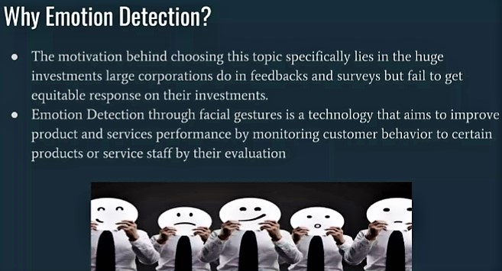
purpose

Slide 4
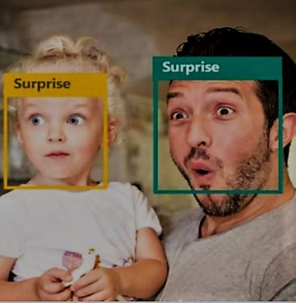
INTRODUCTION Generally human beings can convey intentions and emotions through nonverbal ways such as gestures, facial expressions and involuntary languages. This system can besignificantly useful, nonverbal way for people to communicate with each other. The important thing is how fluently the system detects or extracts the facial expression from image. The system is growing attention because this could be widely used in many fields like lie detection, medical assessment and human computer interface.

Slide 5
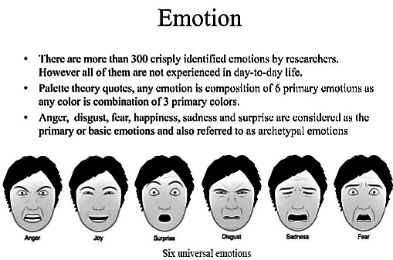

Slide 6
features
Overall, observers were mostly relying on the eye and mouth regions when successfully recognizing an emotion.
Furthermore, the difference in the importance of eyes and mouth allowed to group the expressions in a continuous space, ranging from sadness and fear (reliance on the eyes) to disgust and happiness (mouth)

Slide 7
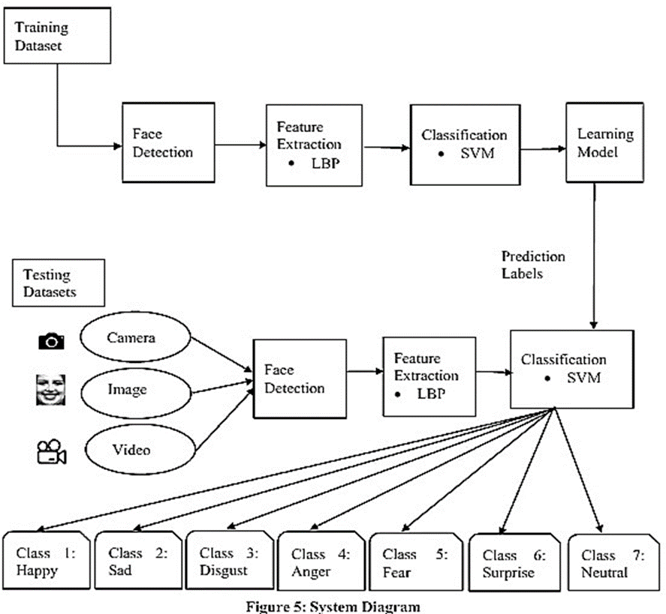

Slide 8
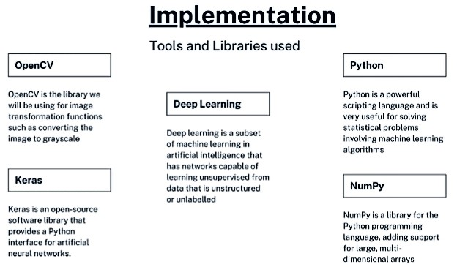

Slide 9
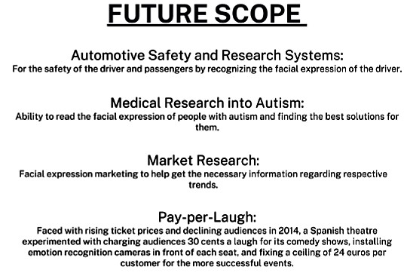

Slide 10
REFERENCES
https://www.google.com/
https://www.fritz.ai/emotion detection/
https://www.clarifai.com/blog
https://facial.comet.ml/
https://medium.com/

